Slide 1
Pong Walkthrough
How to make Pong on Android
Jenelle C - W2019

Slide 2
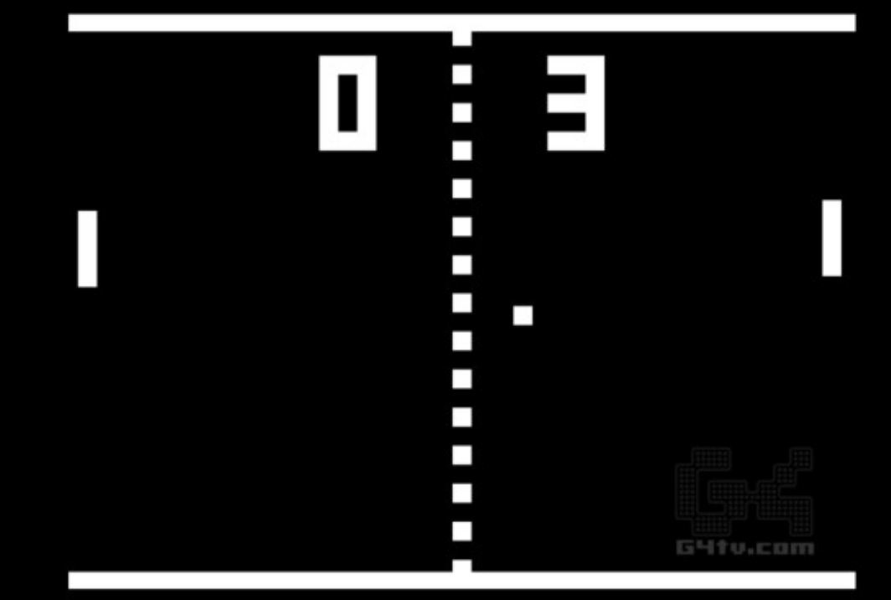
What we are building:
A simple android version of PONG-elle:
https://repl.it/@jenellecodes/Pong
This is the actual PONG!
But we will build something much simpler

Slide 3
Things to pay attention to
Pay attention to the code needed for:
Drawing objects on the screen
Updating their positions
Moving things
Detecting collisions
Keeping score
Playing sounds

Slide 4
We will build in stages:
Draw a ball
Draw a racket
Make the ball move
Make ball bounce once
Make ball bounce forever
Increase score when ball bounces off the racket
Move the racket left and right
Play sounds

Slide 5
Project Setup
Create a new Android project
In your MainActivity.java file, delete everything AFTER the package statement
Paste in the code from the Android Game Starter Template

Slide 6
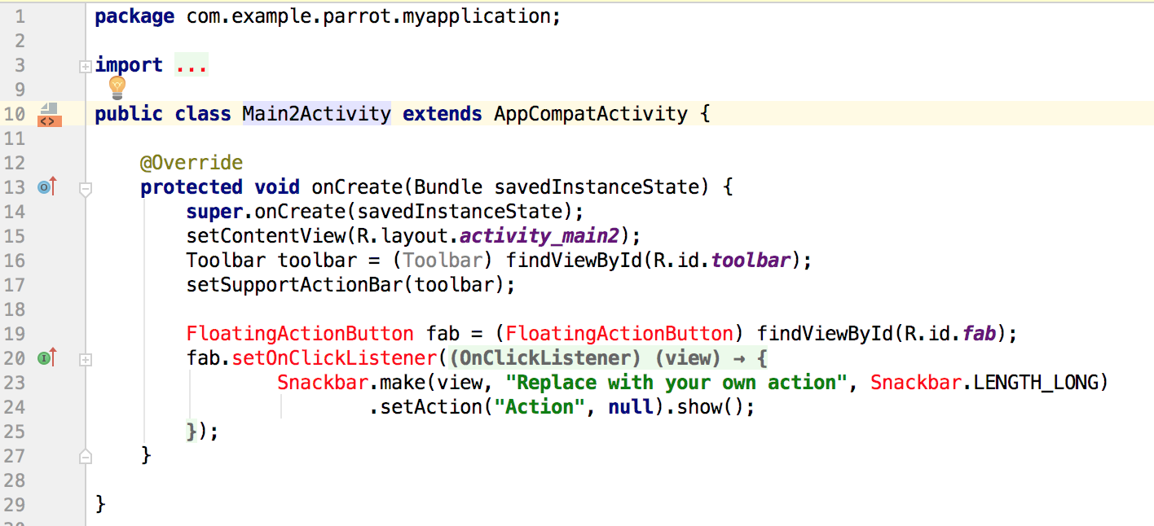
KEEP THIS
DELETE ALL THIS

Slide 7
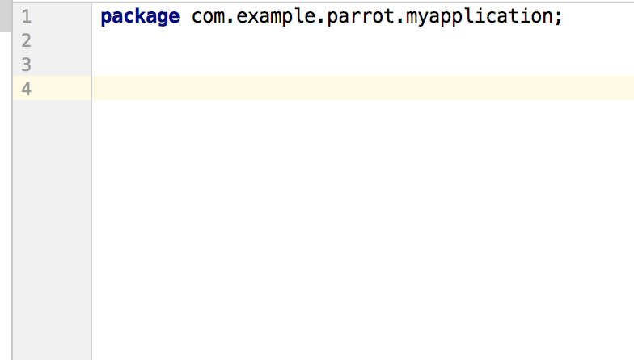
Copy and paste code Android Game Template into this section
Link to template:
https://bitbucket.org/jenelleteaches/android-templateforgames/src/master/MainActivity.java

Slide 8
Let’s start coding!
Remember to check the Drawing With Canvas notes for useful functions!

Slide 9
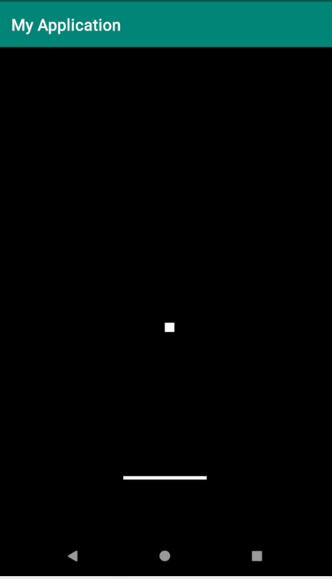
Draw a ball on the screen
Code that was added:
https://bitbucket.org/jenelleteaches/android2d-pongclone/commits/b8c6687b8bfb1a64e83126437ba911e5b590cc81
Final code:
https://bitbucket.org/jenelleteaches/android2d-pongclone/src/b8c6687b8bfb1a64e83126437ba911e5b590cc81/MainActivity.java?at=master

Slide 10
if (this.holder.getSurface().isValid()) {
// get the canvas and prevent other apps
// from modifying it
canvas = this.holder.lockCanvas();
// PUT YOUR DRAWING CODE HERE
// release the canvas so other apps can
// access it
this.holder.unlockCanvasAndPost(canvas);
}

Slide 11
2. Draw a racket
Code that was added:
https://bitbucket.org/jenelleteaches/android2d-pongclone/commits/3e1bd77e9138e97d97a31cdc9b016be671ed3521
Final code:
https://bitbucket.org/jenelleteaches/android2d-pongclone/src/3e1bd77e9138e97d97a31cdc9b016be671ed3521/MainActivity.java

Slide 12
3. Make ball move
Code that was added:
https://bitbucket.org/jenelleteaches/android2d-pongclone/commits/ee97684b3b9d5bd08b179bc598d032cdaa6fad47
Final code:
https://bitbucket.org/jenelleteaches/android2d-pongclone/src/ee97684b3b9d5bd08b179bc598d032cdaa6fad47/MainActivity.java

Slide 13
4. Make ball “bounce”
Code that was added:
https://bitbucket.org/jenelleteaches/android2d-pongclone/commits/cd0d061e783b1b1eb24f1433281b8f377bc2bbc2
Final code:
https://bitbucket.org/jenelleteaches/android2d-pongclone/src/cd0d061e783b1b1eb24f1433281b8f377bc2bbc2/MainActivity.java

Slide 14
5. Make ball bounce forever!
Homework:
Make your ball bounce off the top and bottom walls, forever!
Solution:
https://bitbucket.org/jenelleteaches/android2d-pongclone/commits/f0c850aa7ad1860098ae3771c3a360a93b37c2df

Slide 15
6. Make ball bounce off racket
Problem:
Write the code to detect when the ball hits the racket.
Added code:
https://bitbucket.org/jenelleteaches/android2d-pongclone/commits/34bc3685e0f618b2efcaa105dd4cad2f02b69182
Final Code:
https://bitbucket.org/jenelleteaches/android2d-pongclone/src/34bc3685e0f618b2efcaa105dd4cad2f02b69182/MainActivity.java

Slide 16
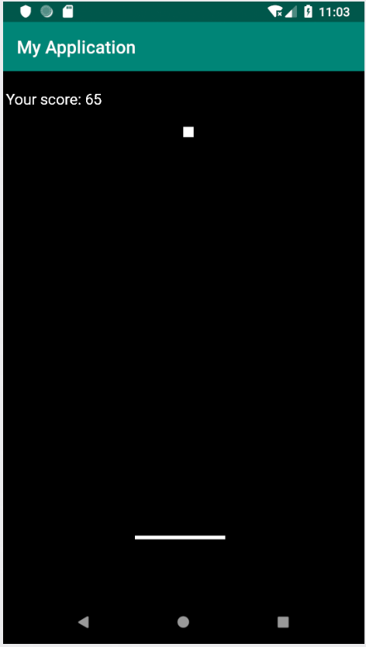
7. Show a score
Problem:
When ball hits the racket, increase the score.
Added code:
https://bitbucket.org/jenelleteaches/android2d-pongclone/commits/ea17733a2722309b7817f51b3b046c19a89fa32e
Final Code:
https://bitbucket.org/jenelleteaches/android2d-pongclone/src/ea17733a2722309b7817f51b3b046c19a89fa32e/MainActivity.java

Slide 17
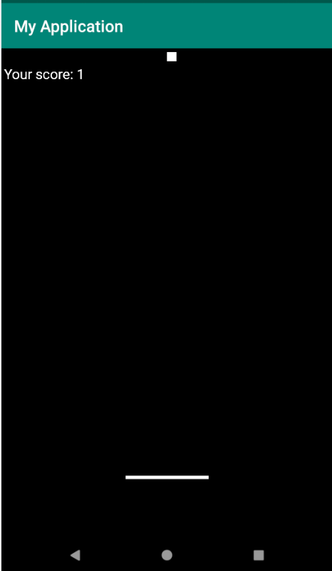
8. Respond to taps
Problem:
Make the racket move left and right.
When person taps on left side of screen, move the racket LEFT
When person taps right side of screen, move racket RIGHT.
Added code:
https://bitbucket.org/jenelleteaches/android2d-pongclone/commits/a83520c40f28a342256684ea2ca4b2468d6bf079
Final Code:
https://bitbucket.org/jenelleteaches/android2d-pongclone/src/a83520c40f28a342256684ea2ca4b2468d6bf079/MainActivity.java
TAP LEFT,
MOVE LEFT
TAP RIGHT,
MOVE RIGHT

Slide 18
Solution:
Detect a tap ---> onTouchEvent()
Get position of the tap
Compare position of tap to the middle of the screen
If tap is on left, move racket Position to left
If tap is on right, move racket position to right

Slide 19
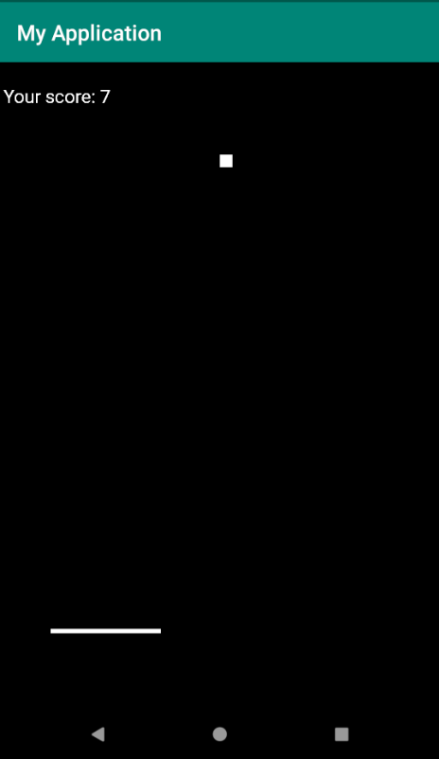
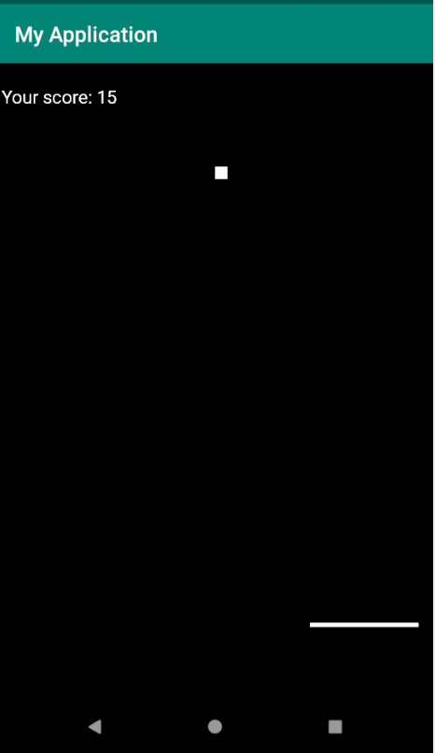
Expected Result
Tap left, racket moves left
Tap right, racket moves right

Slide 20
9. Add a “bounce” sound
Problem:
When ball bounces, play a “bounce” sound.
Solution:
Get a “bounce” sound
Load sound into your game
When ball hits the racket (or wall), play the sound
Here is a nice bounce sound: https://freesound.org/people/bumpelsnake/sounds/456563/

Slide 21
To add sounds to your project:
Create an assets folder in your project: http://code2care.org/2015/create-assets-folder-in-android-studio/
Copy the sound into the assets folder
Write the code to load the sound
Code to add:
https://bitbucket.org/jenelleteaches/android2d-pongclone/commits/e07398742df7aee2b1ece4d507e84c7c9c2b02a2

Slide 22
Final code:
https://bitbucket.org/jenelleteaches/android2d-pongclone/src/e07398742df7aee2b1ece4d507e84c7c9c2b02a2/MainActivity.java

Slide 23
DONE!
At this point, you will have a very basic version of PONG.
But the game has bugs!
And it’s boring (too simple).
So let’s fix it!

Slide 24
Game Enhancements and Bug Fixes

Slide 25
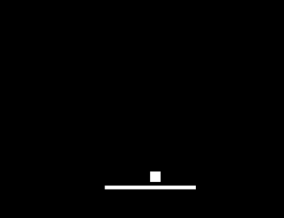
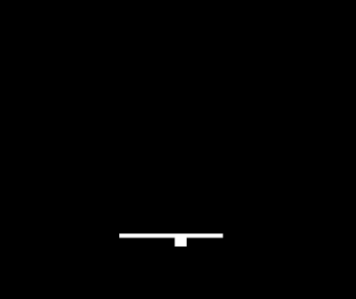
Game Improvements
Make ball bounce in LEFT & RIGHT directions
Add lives (3 lives total, then game over!)
Fixing the racket bug
Integrating with Android Lifecycle → what happens when app goes to background?
Bounce left & right
Racket bug

Slide 26
Racket Bug
Currently, the ball will always bounce off the bottom of the screen.
It doesn’t matter if the ball touched the racket ---> it will still bounce.

Slide 27
Racket Bug
Fix the code:
When ball touches any position INSIDE the racket, make it bounce
When ball is NOT inside the racket, make it fall down
(x, y)
(x+width, y)
(x, y+height)
(x+width, y+height)
Ball’s (x,y) is inside the racket
Therefore, it must be touching the racket!

Slide 28
Solution to Racket Bug
Code Added:
https://bitbucket.org/jenelleteaches/android2d-pongclone/commits/e6434a0c0be07f5cb80c9aed199599b3c143596f
Final Code:
https://bitbucket.org/jenelleteaches/android2d-pongclone/src/e6434a0c0be07f5cb80c9aed199599b3c143596f/MainActivity.java

